Slide 1



Ic161 project
Team: zenith69

Slide 2


Components
ARDUINO
MULTIPLE LEDs
RESISTORS
BREADBOARD

Slide 3
About the project
Our project is a password guessing game in which you have to guess a sequence of the 4 uniquely labelled buttons. The first password is hardcoded into the program, but after guessing correctly once, the game will randomly set a new password, one that even the programmers don’t know!
If you press the correct button at a particular position the green LEDs lights up giving a clue to the player.
If you input a completely incorrect key the red LED lights up.

Slide 4
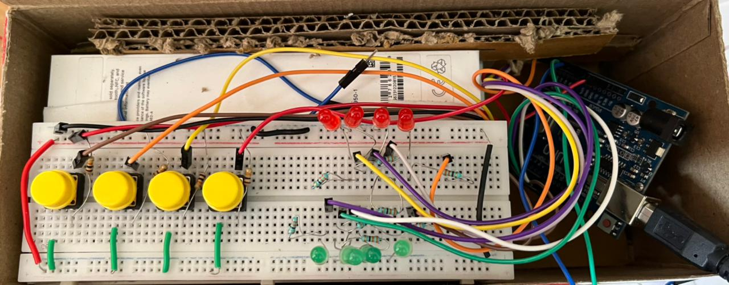
The Circuit
Resistance are connected to LED so that the filament doesn't get damaged.
The resistor connected to the buttons is there to prevent the short by limiting the current flowing; typically 1k to 10k in value.

Slide 5
Code implementation
The game has been designed using simple C++ code, utilizing the Arduino_AVRSTL.h library, allowing us to use simple Standard Library structures like Vectors.
The code itself is extremely simple and can be understood by reading it (we made sure to comment well)!

Slide 6
Gameplay/RULES
The player first enters a sequence of 4 button presses (repeated presses don't count). E.g., they might enter 1-2-3-4.
If the sequence is 100% correct all the lights flash, letting you know you won! A new sequence is now generated and the game starts over.
On the other hand, if none of the presses are in the right place, all 4 red LEDs will flash angrily at you!
If 1 or 2 of the buttons were in their correct place, the same number of green LEDs will flash to let you know how many you got right. Each attempt will give the player new information to use in their next guess.
The player can attempt sequences as many times as they want, frankly because we found this game much harder to play than we expected and adding a limit on attempts seemed cruel.

Slide 7
Project design
Physical circuit design
Arduino code
4 key guessing game

Slide 8

Contact details
b21245@students.iitmandi.ac.in
b21218@students.iitmandi.ac.in
Thank You

